Slide 1
Report to
Final Project
Software Testing (Spring 2018)
Yanqiao ZHU, Yang LI, Jingru GAN, Han LI

Slide 2
Outline
Part 1: Risk Analysis Report
Part 2: Test Suite Design Document
Part 3: Detailed Test Case Design
Part 4: Test Plan

Slide 3
Outline
Part 1: Risk Analysis Report
Part 2: Test Suite Design Document
Part 3: Detailed Test Case Design
Part 4: Test Plan

Slide 4
Level of Extent
Extensive testing
Test the entire risk area
With many variations
Broad testing
Testing the entire risk area
With few variations
Cursory testing
Test a sample of the risk area
Exploring it briefly
Opportunity testing
Test the risk area only if some other test brings to the area
Report bugs
If we see problems in the risk area, report them, but don’t do anything

Slide 5
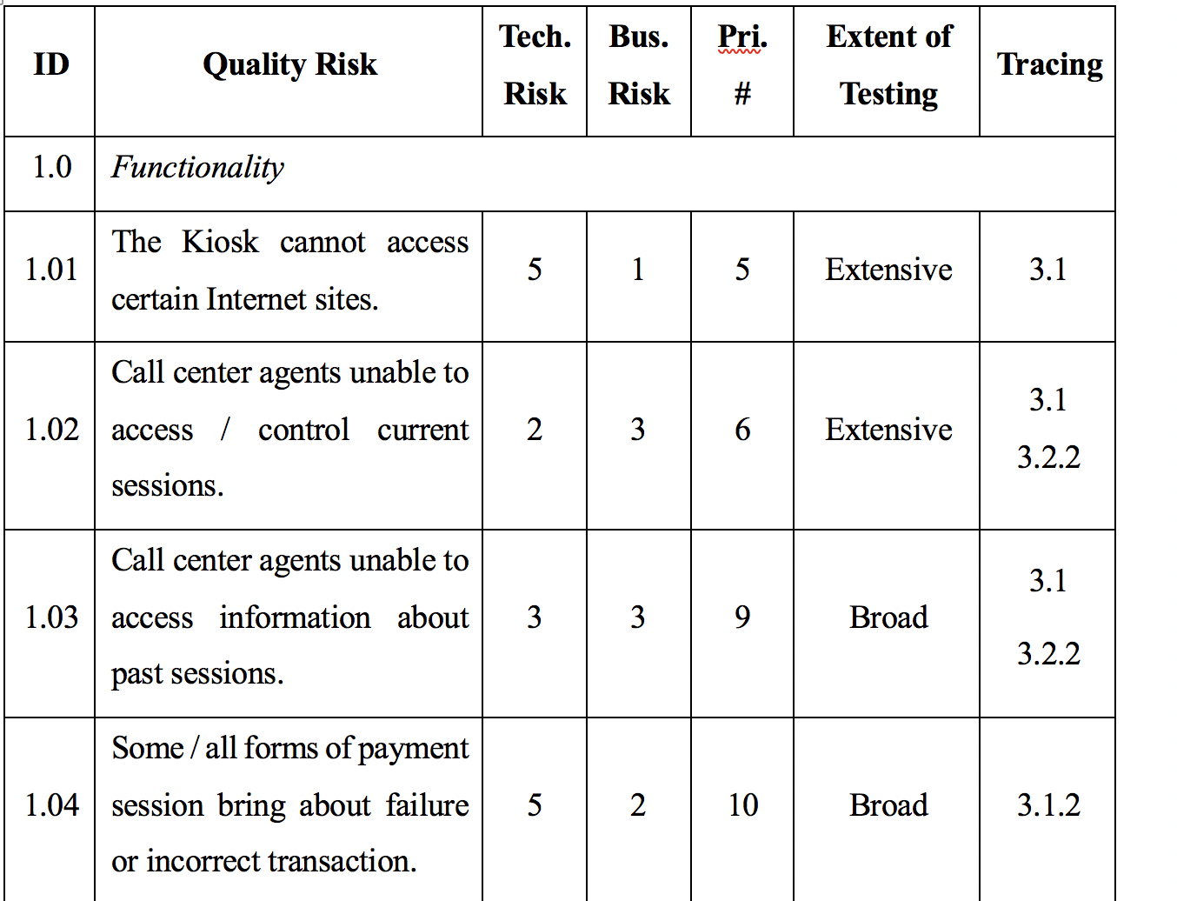
A Brief Glance
Functionality
Localization
Usability and User Interface
Reliability
Performance
Supportability

Slide 6
Rules & Addition
Work directly from specifications made identify the risks straightforward.
Some risks are deviated from what the aggregate risk priority #
Combine some items which have the same risk priority #
Cross-functional teams work together to reduce # of missed risks.
Notes:
1. It is easier to have a written document such as Omninet Marketing Requirements Document.
2.For example, I assigned opportunity testing for “user logout fails,” which had a risk priority number of 10. Why? Because it’s a simple programming task, most likely, and you can easily integrate testing it into some other tests.
3. For example, “call center agents unable to access/control current sessions,” was original two line items, one related to access, one to control.
4. We did this analysis alone, we will missed some important risks of course.

Slide 7
Issues

Slide 8
Outline
Part 1: Risk Analysis Report
Part 2: Test Suite Design Document
Part 3: Detailed Test Case Design
Part 4: Test Plan

Slide 9
Test Suite Group
Kiosk functionality
Call center functionality
Data center functionality

Slide 10
Test Suite Group (cont.)
End-to-end functionality
Reliability
Localization
Security and privacy
Supportability

Slide 11
Test Suite Group (cont.)
Performance
Error handling

Slide 12
Test Suite Group (cont.)
Best test

Slide 13
Outline
Part 1: Risk Analysis Report
Part 2: Test Suite Design Document
Part 3: Detailed Test Case Design
Part 4: Test Plan

Slide 14
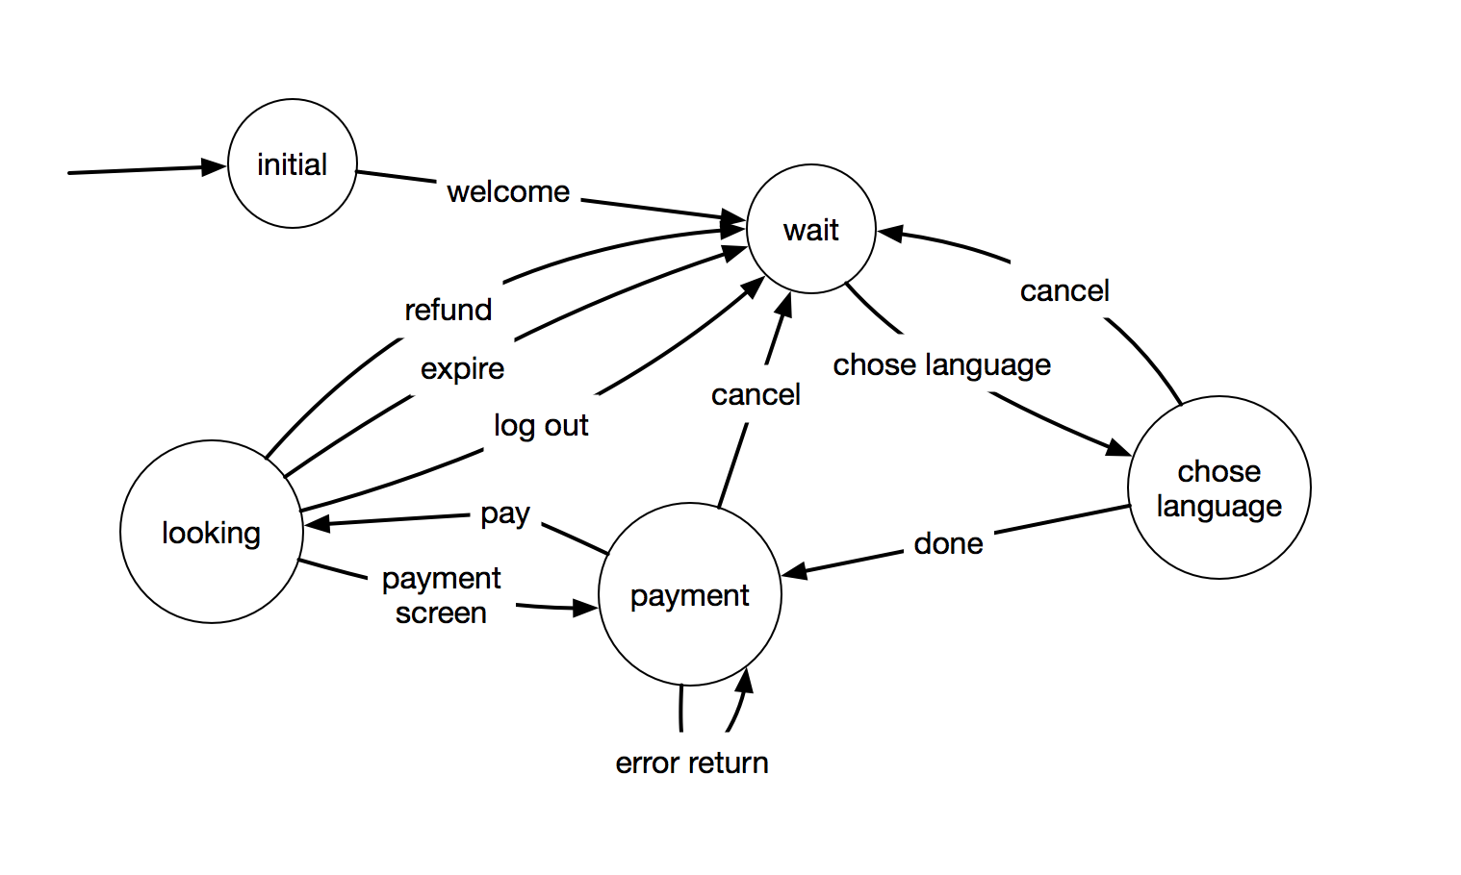
Test Case Design (e.g. payment)

Slide 15
Outline
Part 1: Risk Analysis Report
Part 2: Test Suite Design Document
Part 3: Detailed Test Case Design
Part 4: Test Plan

Slide 16
Test Plan Outline
Identifier
Introduction
Test items
Features to be tested
Features not to be tested
Approach
Item pass/fail criteria
Test deliverables
Test tasks
Environmental needs
Responsibilities
Staffing and training needs
Schedule
Risks and contingencies
Approvals

Slide 17
Concluding Remarks

